Slide 1
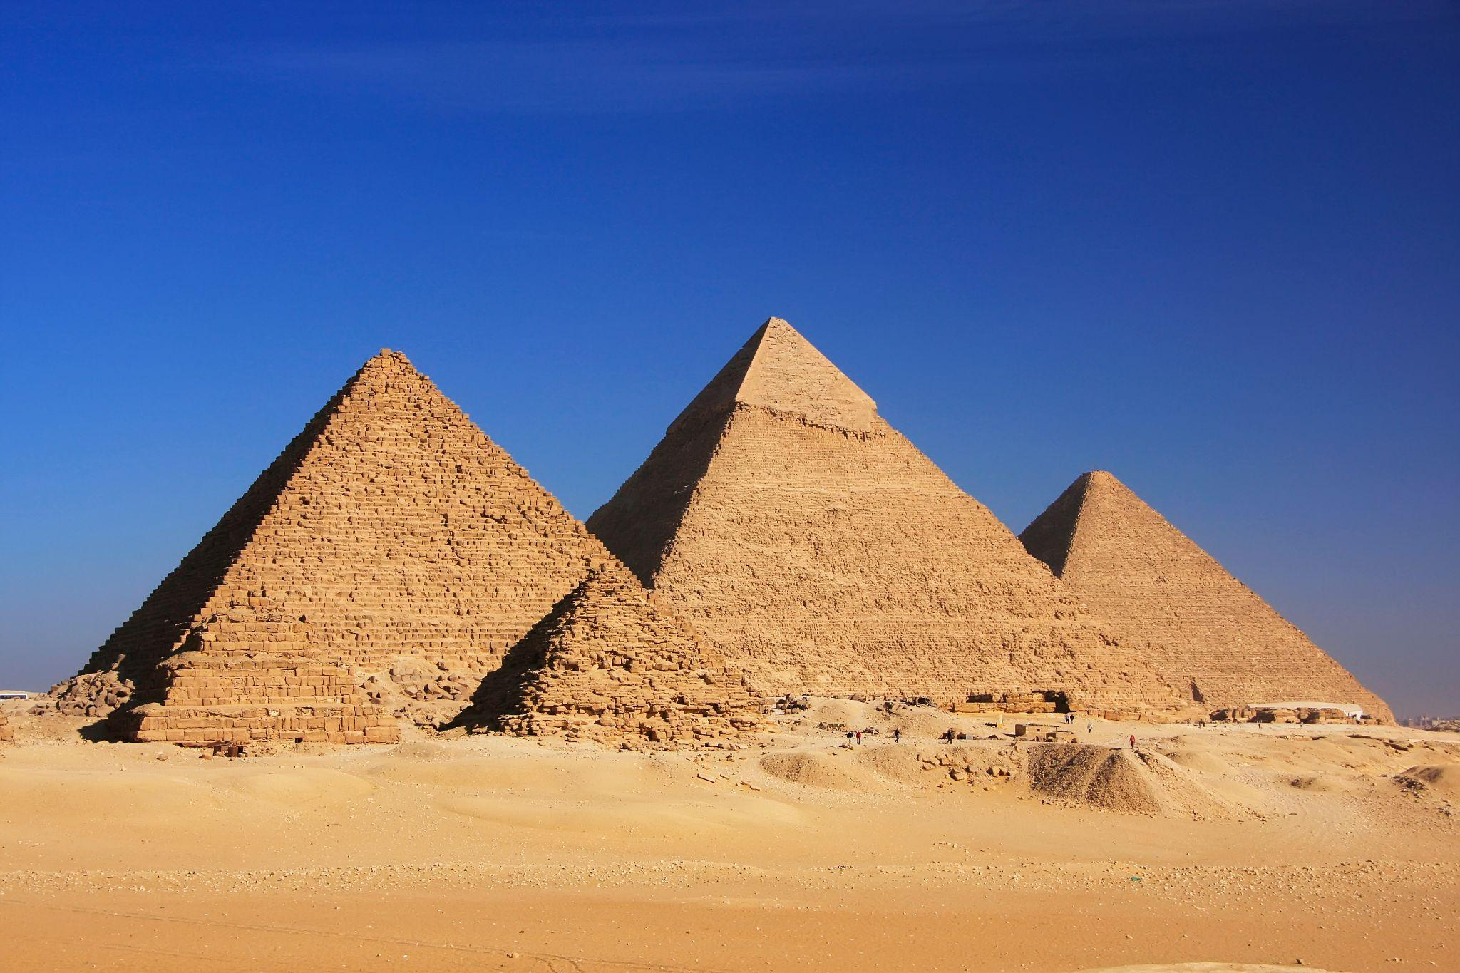

Giza Pyramids Panorama
Image placeholder

Slide 2
Goal
Reach 100 likes and follows in 7 days
Goal

Slide 3
Goal
Reach 100 like and follow in 7 days
Campaign Objective:
Brand Awareness

Slide 4
Goal
Reach 100 like and follow in 7 days
Campaign Objective:
Brand Awareness
KPI:
Like or follow The page

Slide 5
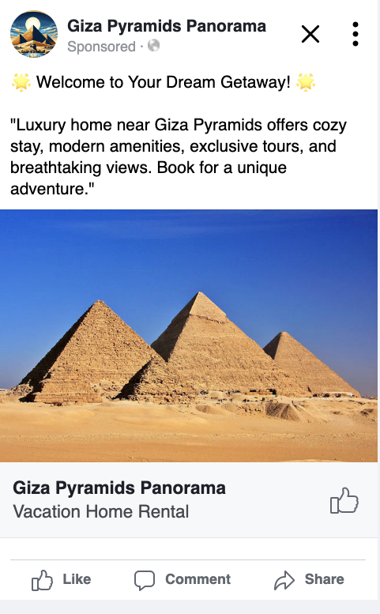
Creative
Assets
Image placeholder
Image placeholder

Slide 6
Campaign
Settings
Objective:
Brand Awareness
Audience:
Age 18-65
All Genders
United States
Home Vacation Rental

Slide 7
Campaign
Settings
Objective:
Brand Awareness
Audience:
Age 18-65
All Genders
United States
Home Vacation Rental
Placement:
Facebook
Duration:
7 Days
Budget:
$ 35.00

Slide 8
Results
Campaign Result
98 Likes
Campaign Cost
$ 28.45
Cost Per Click $ 0.29

Slide 9
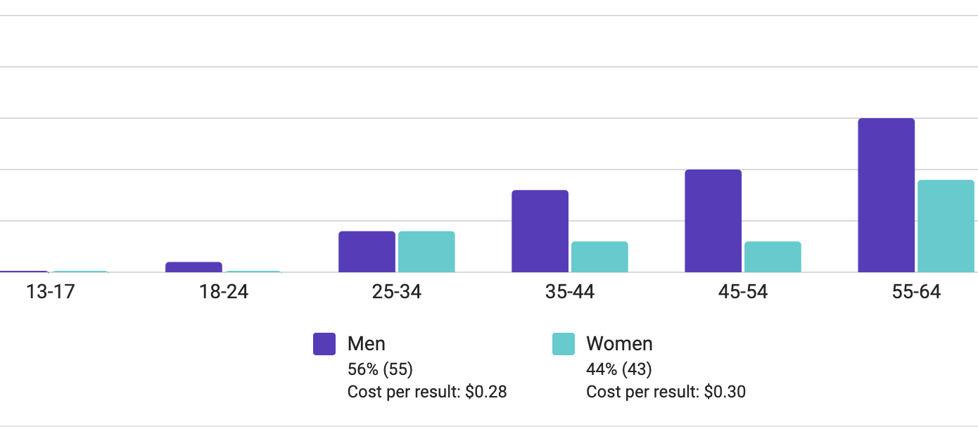

Insights
Cost Per Click
Men $ 0.28
Women $0.30

Slide 10
Conclusion & Next Steps
Create 2 Creatives
Run A/B test to optimize creatives
Keep Targeting both men and women
Expand The Campaign to different Platforms
Text

Slide 11
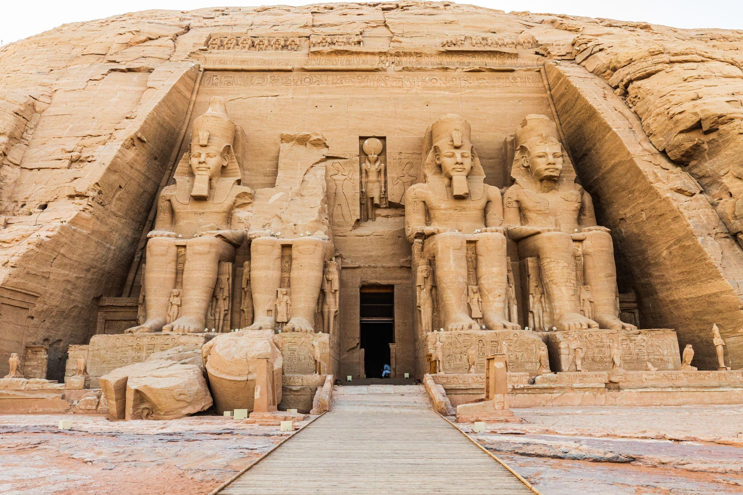

Thank
You!
Image placeholder

